Slide 1

Web App Dev 2
The final talk!

Slide 2
Agenda
Assessment
Other/3rd Party packages
Assignment2
Lab Submission

Slide 3
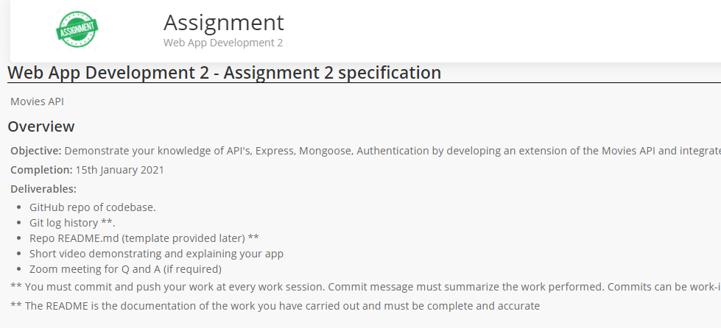
Assignment 2
It’s here: https://tutors-svelte.netlify.app/#/topic/wad2-2020-wit.netlify.app/topic11
30% of your overall mark
Submit on Moodle (Repo)
Due 15th January.

Slide 4
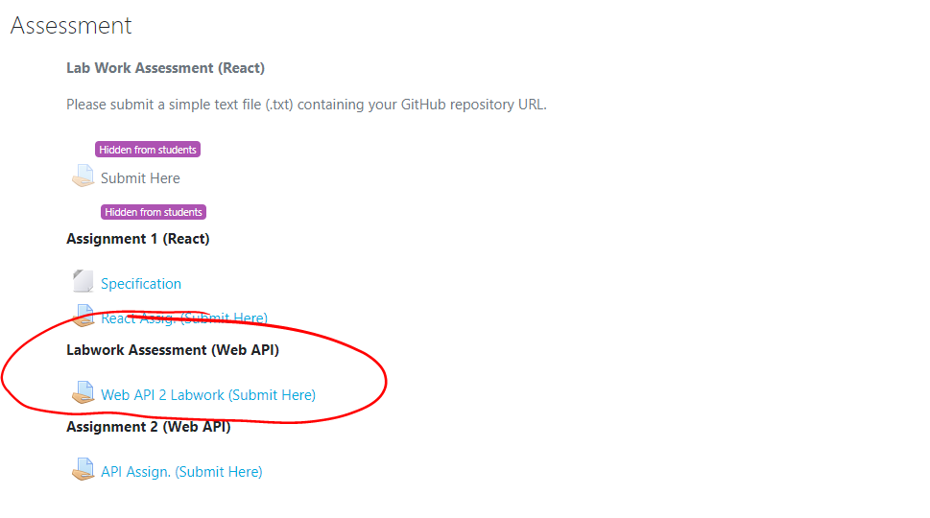
Labwork Assessment
10% of your overall mark
Submit on Moodle by 4th Jan (or earlier if you’re complete)
Will be looking at commit history.
Submit on Moodle(repo)

Slide 5
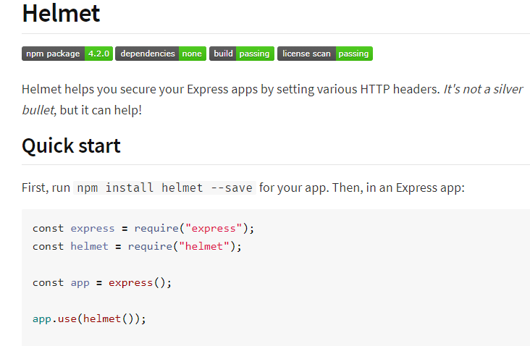
Extra Stuff Examples
Helmet
Better Error Handling
Logging
https://blog.bitsrc.io/23-insanely-useful-nodejs-libraries-you-should-know-in-2020-5a9b570d5416

